Slide 1
Carolina Brew
E.T.L Project
Melinda Eudy,
Kelly Rose, and
Darrius Summers

Slide 2

ETL Project Idea
Covid-19 has created a society with a bit of clausterphobia
What will people want to do now that states are opening back up?
Day trips? Weekend Trips?
Distance? North and South Carolina
Something new!
Result:
Bars in NC and SC
What are they rated?
How expensive?
Reviews?

Slide 3
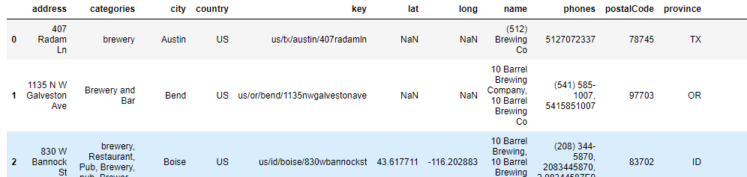
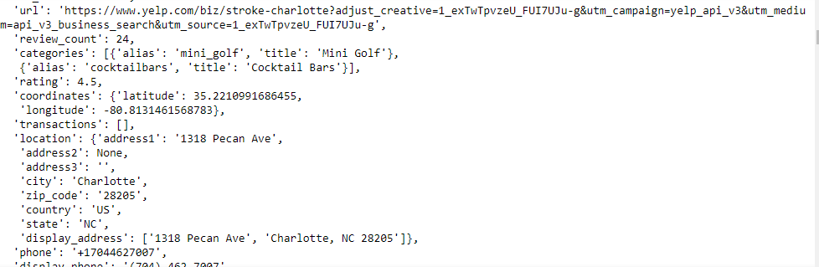
Extraction
Data sets:
KAGGLE - BREWERIES AND BEER PUBS IN THE US (.CSV)
'https://api.yelp.com/v3/businesses/search’ (NC)
'https://api.yelp.com/v3/businesses/search’ (SC)
Initial Files:

Slide 4
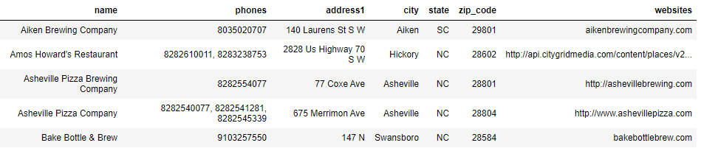
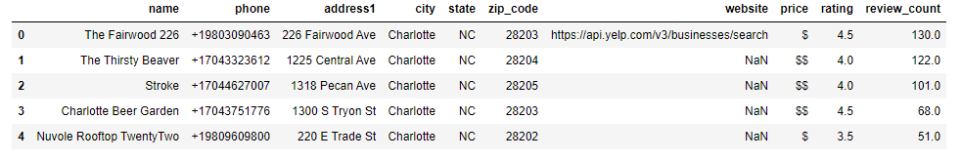
Transform
Kaggle file: remove columns, renamed columns, reorganized columns, removed rows with Nan and finally, sorted to North and South Carolina
Final Result: 77 Bars
Yelp file: created a list of rows of interest—address, bar id, price, rating, and number of reviews. Then placed into a pandas DataFrame.
Final Result : 20 Bars NC & 20 Bars SC

Slide 5
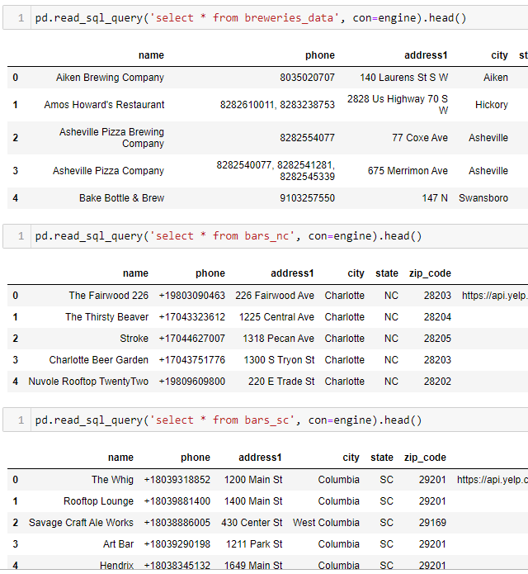
Transform
Sent tables to postgres – pgAdmin4
Confirmed all tables loaded

Slide 6

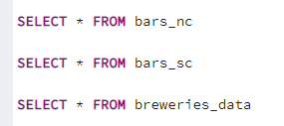
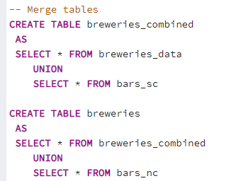
Transform
Altered Breweries_data by adding three columns
Confirmed tables were present in pgAdmin4
Merged tables to create one final table

Slide 7

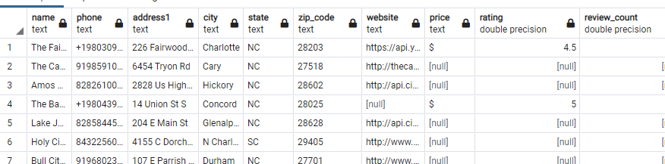
Load
Confirmed data in merged tables (FINAL TABLE: Breweries)
Confirmed size of table – 117 Rows

Slide 8
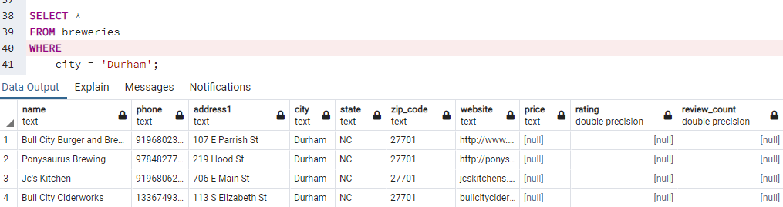
Conclusion
Road Trip:

